Slide 1


Ahmed Gharib
1/1/2023

Slide 2

Outline
Executive Summary
Introduction
Methodology
Results
Conclusion
Appendix

Slide 3
Executive Summary
Summary of Methodologies:
To predict if the first stage would be a success, the following methodologies were used.
Data Collection
Data Wrangling
Exploratory Data Analytics
Interactive Visual Analytics
Predictive Analysis
Summary of Results:
The results were in various forms detailed below.
EDA Results
Interactive dashboard
Predictive analysis of classification models

Slide 4
Introduction
The commercial space age is growing, SpaceX Falcon 9 rockets are leading in the industry currently as they are considerably cheaper than any alternatives provided by competitors, this is because they are reusable. We can use the first stage of the rocket again for another flight, this brings down the costs.
If we can predict the success rate of the first stage, we can predict the costs. Using this we can determine if an alternative operative should bid for the launch.
The main purpose of the project is to determine if the first stage will be successful.

Slide 5

Section 1

Slide 6
Methodology
I’ve have performed all the methods stated below
Data Collection
Collecting Data from SpaceX API
Data Wrangling
Classifying the status of the landings (success or failure)
EDA
Using python libraries (Pandas and Matplotlib) to display and determine patterns between variables
Predictive Analysis using Classification Models

Slide 7
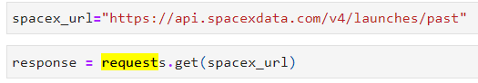
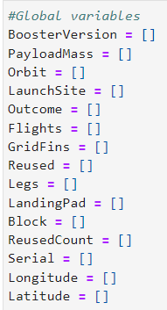
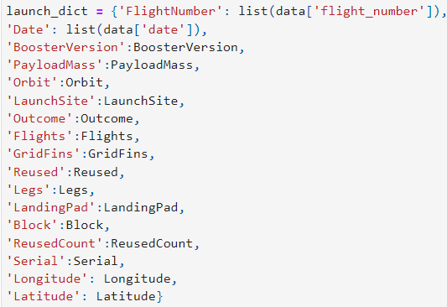

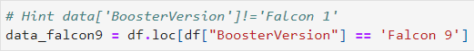

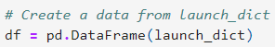

GitHub URL
https://github.com/ahmed-gharib89/IBM-Applied-Data-Science-Capstone/blob/main/jupyter-labs-spacex-data-collection-api.ipynb
Data Collection – SpaceX API
1
2
4
3
5
6
1
2
.JSON file + Lists(Launch Site, Booster Version, Payload Data)
3
4
5
Filter data to only include Falcon 9 launches
6
Request (Space X APIs)
Json_normalize to DataFrame data from JSON
Cast dictionary to a DataFrame
Imputate missing PayloadMass values with mean

Slide 8



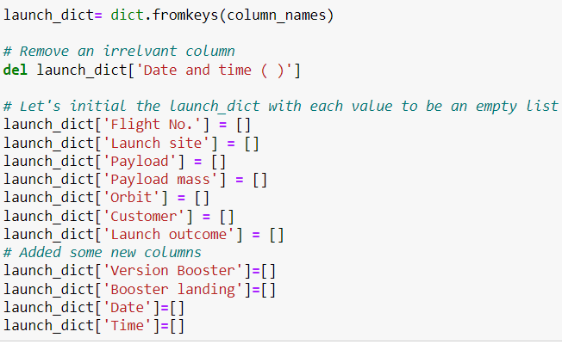

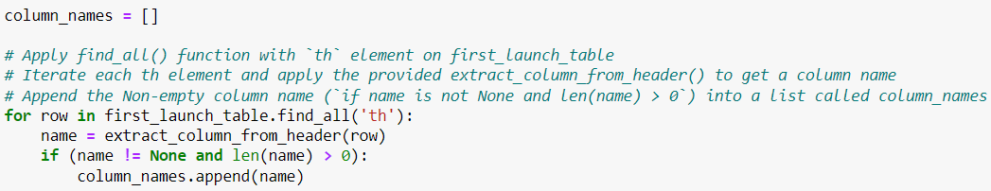

GitHub URL
https://github.com/ahmed-gharib89/IBM-Applied-Data-Science-Capstone/blob/main/jupyter-labs-webscraping.ipynb
Data Collection - Scraping
1
2
4
3
5
1
Request Wikipedia
html
2
Create BeautifulSoup Object
3
4
Iterate through table cells to extract data to dictionary
5
Find launch info html table
Create dictionary into a Pandas DataFrame

Slide 9
GitHub URL
https://github.com/ahmed-gharib89/IBM-Applied-Data-Science-Capstone/blob/main/labs-jupyter-spacex-Data%20wrangling.ipynb
Data Wrangling
Create a training label with landing outcomes where successful = 1 & failure = 0.
Outcome column has two components: ‘Mission Outcome’ ‘Landing Location’
New training label column ‘class’ with a value of 1 if ‘Mission Outcome’ is True and 0 otherwise. Value Mapping:
True ASDS, True RTLS, & True Ocean – set to -> 1
None None, False ASDS, None ASDS, False Ocean, False RTLS – set to -> 0

Slide 10
GitHub URL
https://github.com/ahmed-gharib89/IBM-Applied-Data-Science-Capstone/blob/main/jupyter-labs-eda-dataviz.ipynb
EDA with Data Visualization
Exploratory Data Analysis performed on variables Flight Number, Payload Mass, Launch Site, Orbit, Class and Year.
Plots Used:
Flight Number vs. Payload Mass, Flight Number vs. Launch Site, Payload Mass vs. Launch Site, Orbit vs. Success Rate, Flight Number vs. Orbit, Payload vs Orbit, and Success Yearly Trend
Scatter plots, line charts, and bar plots were used to compare relationships between variables to
decide if a relationship exists so that they could be used in training the machine learning model

Slide 11
GitHub URL
https://github.com/ahmed-gharib89/IBM-Applied-Data-Science-Capstone/blob/main/jupyter-labs-eda-sql-coursera_sqllite.ipynb
EDA with SQL
The following were the sql queries performed, this is how we brought about our results
- Display the names of the unique launch sites in the space mission
- Display 5 records where launch sites begin with the string 'CCA’
- Display the total payload mass carried by boosters launched by NASA (CRS)
- Display average payload mass carried by booster version F9 v1.1
- List the date when the first succesful landing outcome in ground pad was acheived.
- List the names of the boosters which have success in drone ship and have payload mass greater than 4000 but less than 6000
- List the total number of successful and failure mission outcomes
- List the names of the booster_versions which have carried the maximum payload mass. Use a subquery
- List the records which will display the month names, failure landing_outcomes in drone ship ,booster versions, launch_site for the months in year 2015.
- Rank the count of successful landing_outcomes between the date 04-06-2010 and 20-03-2017 in descending order

Slide 12
GitHub URL
https://github.com/ahmed-gharib89/IBM-Applied-Data-Science-Capstone/blob/main/lab_jupyter_launch_site_location.ipynb
Build an Interactive Map with Folium
The following tasks and subtasks were dictated to us with in Data Visualization With Folium Notebook.
Mark all launch sites on a map
• Initialise the map using a Folium Map object
• Add a folium.Circle and folium.Marker for each launch site on the launch map
Mark the success/failed launches for each site on a map
• As many launches have the same coordinates, it makes sense to cluster them together.
• Before clustering them, assign a marker colour of successful (class = 1) as green, and failed (class = 0) as red.
• To put the launches into clusters, for each launch, add a folium.Marker to the MarkerCluster() object.
• Create an icon as a text label, assigning the icon_color as the marker_colour determined previously.
Calculate the distances between a launch site to its proximities
• To explore the proximities of launch sites, calculations of distances between points can be made using the Lat and Long values.
• After marking a point using the Lat and Long values, create a folium.Marker object to show the distance.
• To display the distance line between two points, draw a folium.PolyLine and add this to the map.
We completed the task to get our results.

Slide 13
GitHub URL
https://github.com/ahmed-gharib89/IBM-Applied-Data-Science-Capstone/blob/main/SpaceX_Machine%20Learning%20Prediction_Part_5.ipynb
Predictive Analysis (Classification)
1
Split label column ‘Class’ from dataset
2
3
4
Fit and Transform Features using Standard Scaler
GridSearchCV (cv=10) to find optimal parameters
data
Train test split data
5
Use GridSearhCV on LogReg, SVM, Decision Tree, and KNN models
6
7
Confusion Matrix for all models
8
Barplot to compare scores of models
Score models on split test set

Slide 14
Results
The Logistic Regression, Support Vector Machine and K nearest neighbors models are the best in terms of accuracy.
Less weighted payloads have more success rate than heaver payloads.
KSC LC 39A Launch Site is the best of all sites
Orbits GEO, HEO, SSO, ES L1 have the best success rate.

Slide 15

Section 2

Slide 16
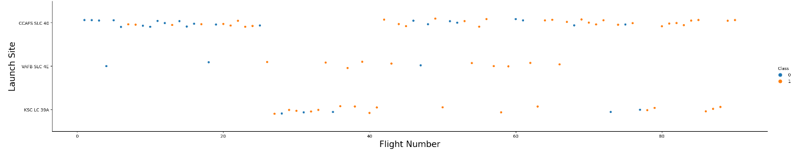
Flight Number vs. Launch Site
Yellow indicates successful launch; Blue indicates unsuccessful launch.
Graphic suggests an increase in success rate as more Flight were launched. Likely a big breakthrough around flight 20 which significantly increased success rate. Above a flight number of around 30, there are significantly more successful landings. CCAFS appears to be the main launch site as it has the most volume.

Slide 17
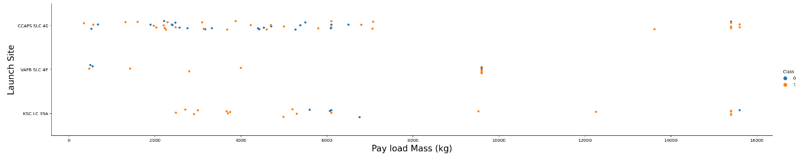
Payload vs. Launch Site
Yellow indicates successful launch; Blue indicates unsuccessful launch.
Payload mass appears to fall mostly between 0-7000 kg. Different launch sites also seem to use different payload mass. Most of the lighter payloads have been launched from CCAFS SLC 40. There is no clear correlation between payload mass and success rate for a given launch site.

Slide 18
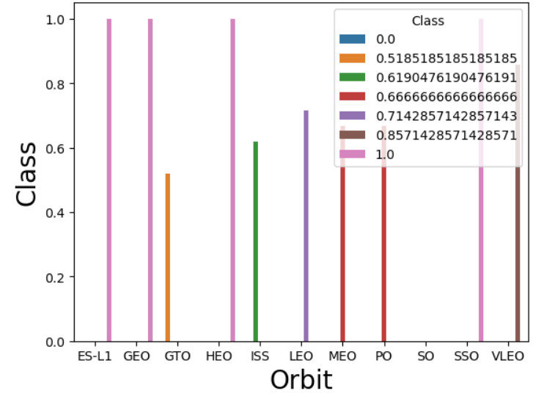
Success Rate vs. Orbit Type
The ES-L1, GEO, HEO and SSO orbits have the highest successful rates.
The SO has the lowest success rate.

Slide 19
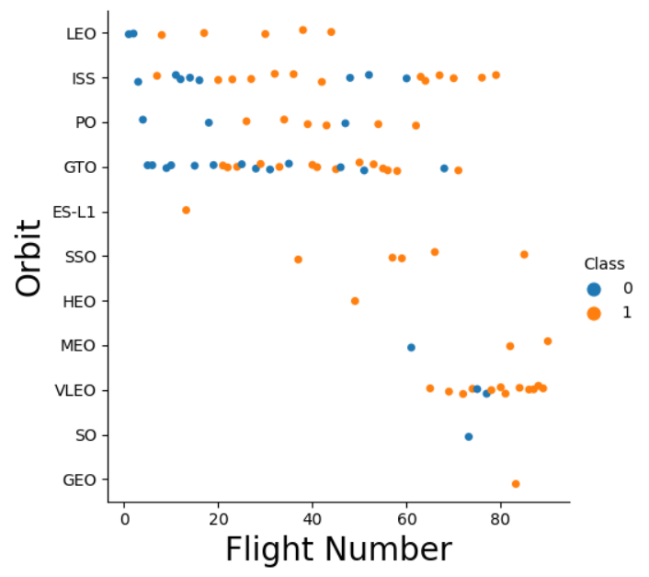
Flight Number vs. Orbit Type
SpaceX started with LEO orbits which saw moderate success LEO and returned to VLEO in recent launches
As seen previously as the Flight Number increases, the success rate increases.
Yellow indicates successful launch; Blue indicates unsuccessful launch.

Slide 20
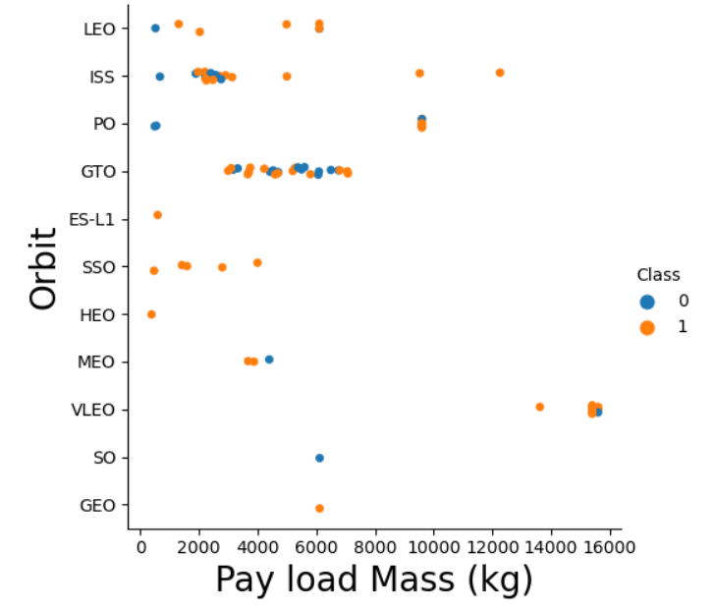
Payload vs. Orbit Type
The relationship between GTO Orbit and Pay Load Mass seems unclear.
This plot is not particularly useful as not enough launches have occurred on different orbits.
Certain Orbits only operate within certain Pay Load Mass intervals, such as VLEO (Very Low Earth Orbit) only operates under the highest mass.
Yellow indicates successful launch; Blue indicates unsuccessful launch.

Slide 21
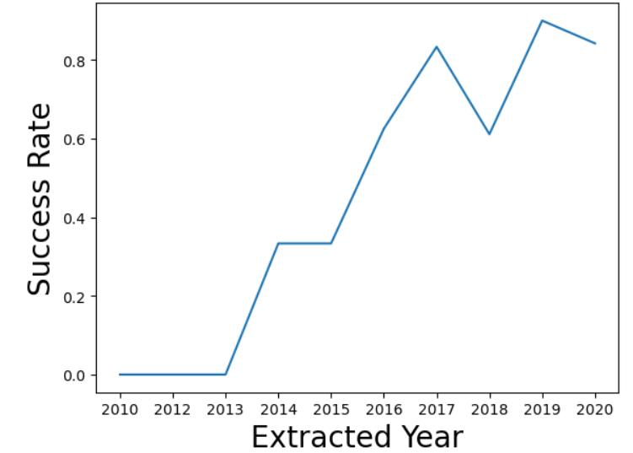
Launch Success Yearly Trend
Success generally increases over time since 2013 with a slight decrease in 2018
Between 2010 and 2013, all landings were unsuccessful (as the success rate is 0).

Slide 22
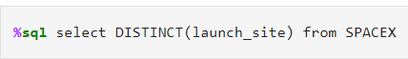
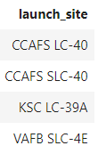
All Launch Site Names
The task is for all Launch site names
There is likely only 3 unique Launch sites, as CCAFS LC-40 and CCAFS SLC-40 are probably one and the same, this aberration may have occurred due to human error.

Slide 23
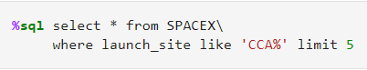
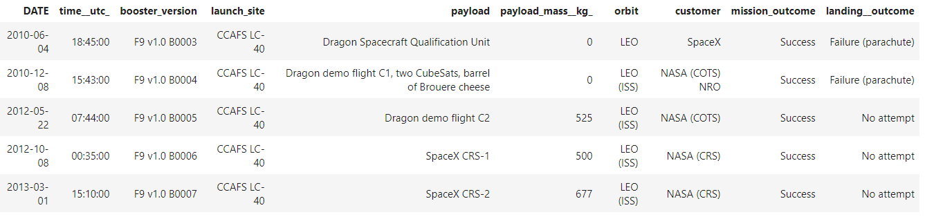
Launch Site Names Begin with 'CCA'
First five entries in database with Launch Site name beginning with CCA.

Slide 24
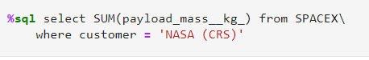
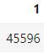
Total Payload Mass
This query sums the total payload mass in kg where NASA was the customer.

Slide 25
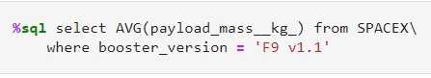
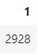
Average Payload Mass by F9 v1.1
This query calculates the average payload mass or launches which used booster version F9 v1.1

Slide 26
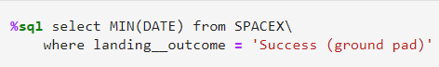
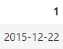
First Successful Ground Landing Date
This query returns the first successful ground pad landing date.

Slide 27

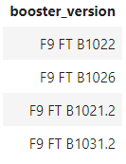
Successful Drone Ship Landing with Payload between 4000 and 6000
This query returns the four booster versions that had successful drone ship landings and a payload mass between 4000 and 6000 noninclusively.

Slide 28
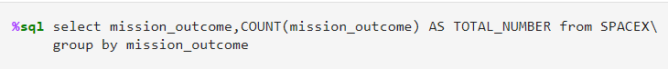
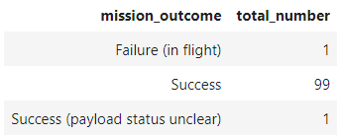
Total Number of Successful and Failure Mission Outcomes
This query returns a count of each
mission outcome.

Slide 29
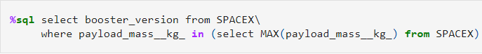
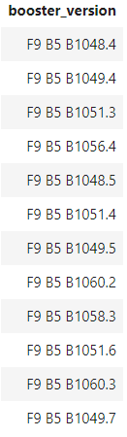
Boosters Carried Maximum Payload
This query returns the booster versions that carried the highest payload mass of 15600 kg.

Slide 30
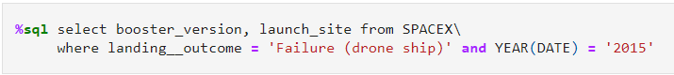
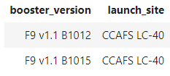
2015 Launch Records
The WHERE keyword is used to filter the results for only failed landing outcomes, and only for the year of 2015.

Slide 31
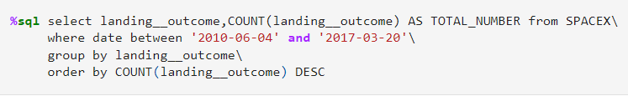
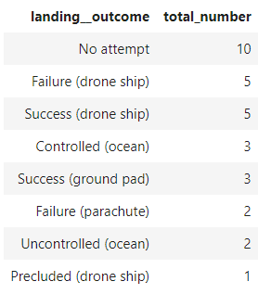
Rank Landing Outcomes Between 2010-06-04 and 2017-03-20
This query returns every possible landing outcome within the specified dates.

Slide 32

Section 3

Slide 33

Launch Site locations
As you can see the launch sites are very close and are on the coast.

Slide 34

Launch markers
Launches have been grouped into clusters, the green icons stand for successful launches and red for failure.

Slide 35
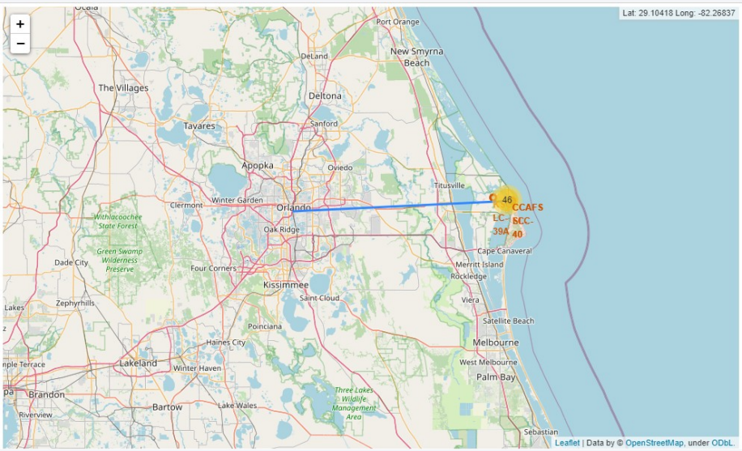
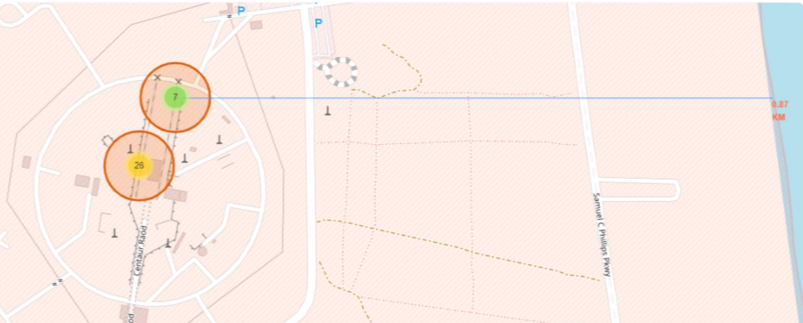
Key Location Distance
We can see that the launch site is very close the water, incase something goes wrong with the launch. We can also see that the launch site is considerable distance from any densely populated area.
The blue line represents the distance from launch area to any location of choice

Slide 36

Section 5

Slide 37
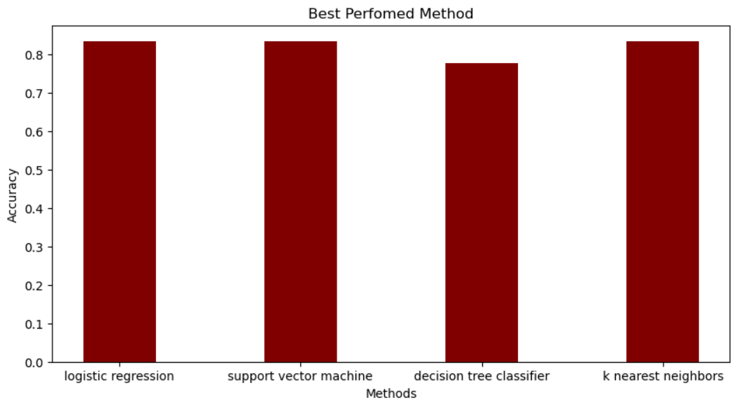
Classification Accuracy
Logistic regression, SVM and KNN are the models that perform the best and, the decision tree is the model with the less accuracy.

Slide 38
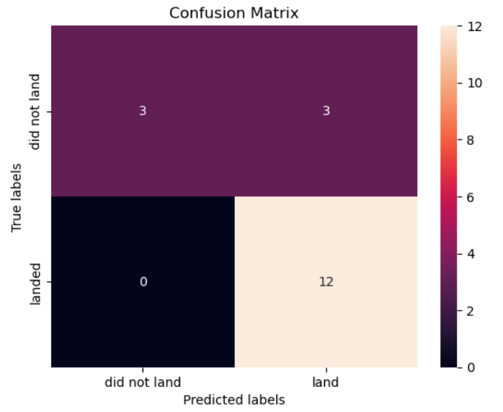
Confusion Matrix
Correct predictions are on a diagonal from top left to bottom right.
Since 3 of our models performed the same for the test set, the confusion matrix is the same across models. The models predicted 12 successful landings correctly
The models predicted 3 unsuccessful landings correctly.
The models predicted 3 successful landings when this didn’t really occur(false positives). Our models over predict successful landings.

Slide 39
Conclusions
Our task was to develop a machine learning model for Space Y who wants to bid against SpaceX
Used data from a public SpaceX API and web scraping SpaceX Wikipedia page
Created data labels and stored data into a DB2 SQL database
Created a dashboard for visualization
We created a machine learning model with an accuracy of 83%
SpaceY can use this model to predict with relatively high accuracy whether a launch will have a successful Stage 1 landing before launch to determine whether the launch should be made or not
If possible more data should be collected to better determine the best machine learning model and improve accuracy

Slide 40


